Slide 1


September 2014,
author | Ognen Kostovski
professor | Davide Martinenghi
Call Statistics
get
Control
over your phone bills
Notes:
IBM in the UK & Ireland
Version 5 – updated September 2013

Slide 2
How it will make a difference?
match needs & services
compare operators
compare models
monthly statistics
Reduce your bill
best tariff match
save money
call log

Slide 3
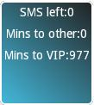
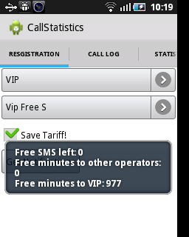
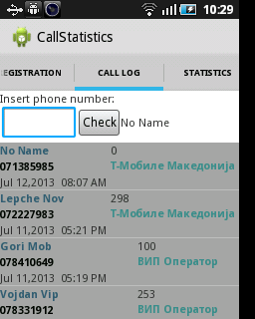
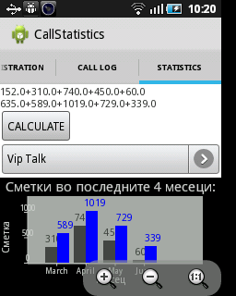
main screens
widget

